Slide 1
SIEM Log Monitoring using Splunk Enterprise
System & Security Log Analysis with Dashboards
Project By: Jheel Bhandia

Slide 2
Agenda
Introduction to SIEM
What is SIEM?
Why SIEM is Important?
Problem Statement
Project Objective
Tools & Environment
Splunk Installation
Log Collection (systemd / journal)
Dashboard Creation
Results & Observations
Conclusion

Slide 3
INTRODUCTION
In today’s digital world, systems generate a large number of logs related to user activity, system performance, and security events. Monitoring these logs manually is difficult and inefficient.
SIEM (Security Information and Event Management) is a solution that helps organizations collect, analyze, and visualize logs in real time to detect security incidents and system issues.
In this project, Splunk Enterprise is used as a SIEM tool to monitor systemd journal logs and internal system logs on a Kali Linux system. The project demonstrates real-time log monitoring, error detection, and dashboard visualization similar to a SOC (Security Operations Center) environment.

Slide 4
What is SIEM?
SIEM (Security Information and Event Management):
Centralized log collection system
Correlates events from multiple sources
Detects security threats and system errors
Provides real-time monitoring and alerts
Used by SOC teams for incident response
Examples:
Splunk, IBM QRadar, ArcSight, LogRhythm

Slide 5
Why SIEM is Important?
Continuous security monitoring
Early detection of attacks and failures
Centralized visibility of logs
Faster incident response
Helps meet compliance requirements

Slide 6
Problem Statement
Organizations face challenges such as:
Huge volume of system logs
Difficulty in identifying errors manually
Lack of real-time visibility
Delayed response to system failures
Solution:
Implement a SIEM solution using Splunk Enterprise to monitor system logs and visualize errors effectively.

Slide 7
Project Objective
Monitor system logs using Splunk
Analyze systemd / journal logs
Detect errors and abnormal activity
Visualize data using dashboards

Slide 8
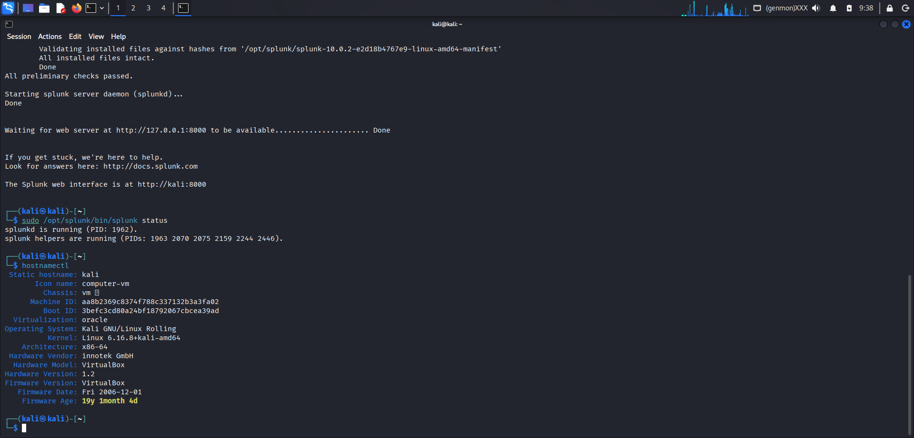
Tools & Environment
OS: Kali Linux
SIEM Tool: Splunk Enterprise
Logs: systemd journal, splunk internal logs
Interface: Splunk Web (Search & Reporting)

Slide 9
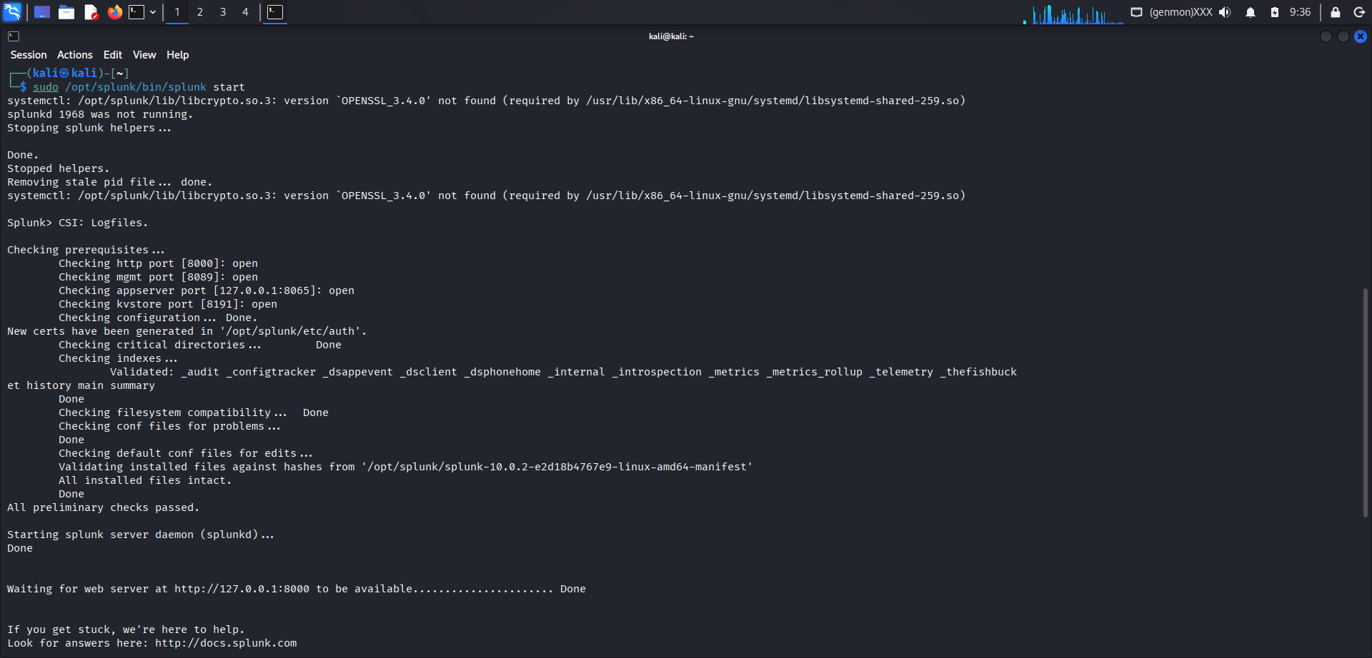
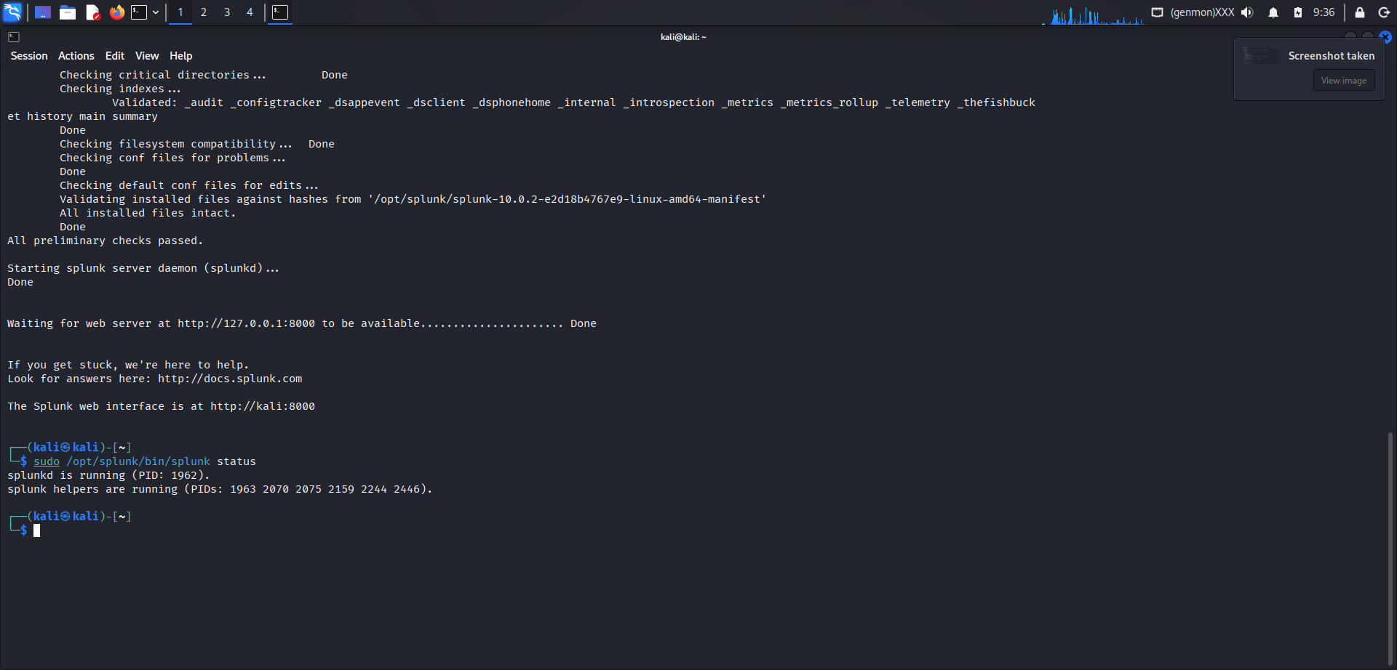
Splunk Installation
Splunk installed on Kali Linux
Splunk service started successfully
Web interface accessible on port 8000

Slide 10
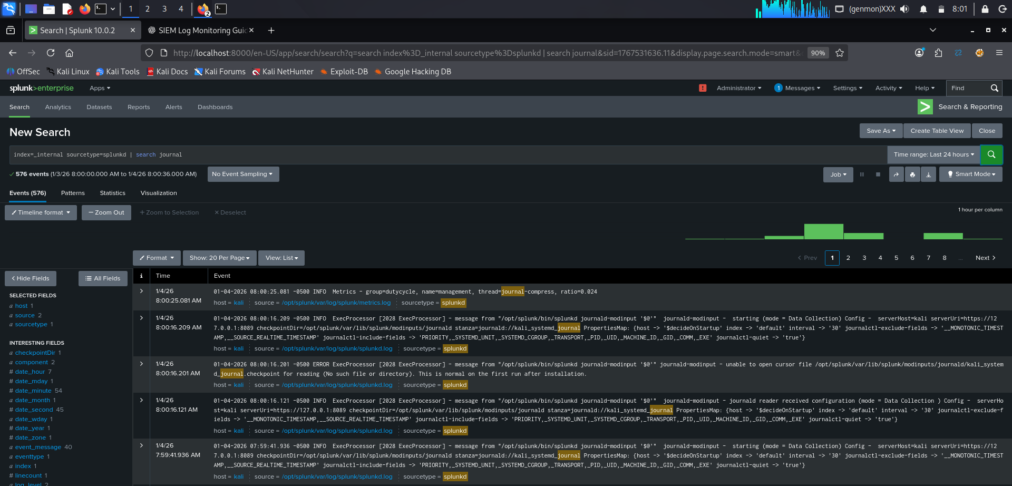
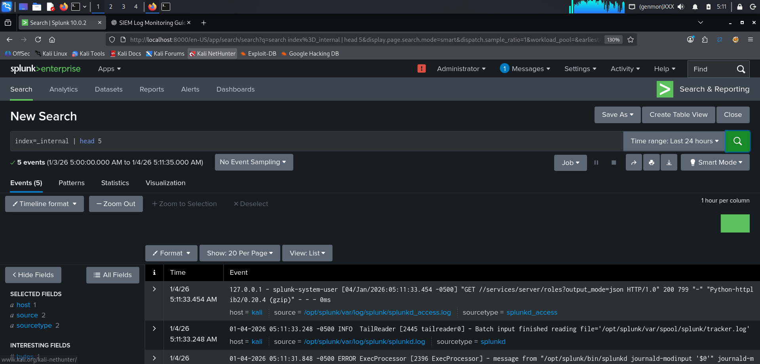
Log Collection (systemd / journal)
systemd journal input enabled in Splunk
Logs collected from Linux system services
Events ingested via splunkd journal input
Data indexed into _internal index
Enables monitoring of system-level activity and errors

Slide 11
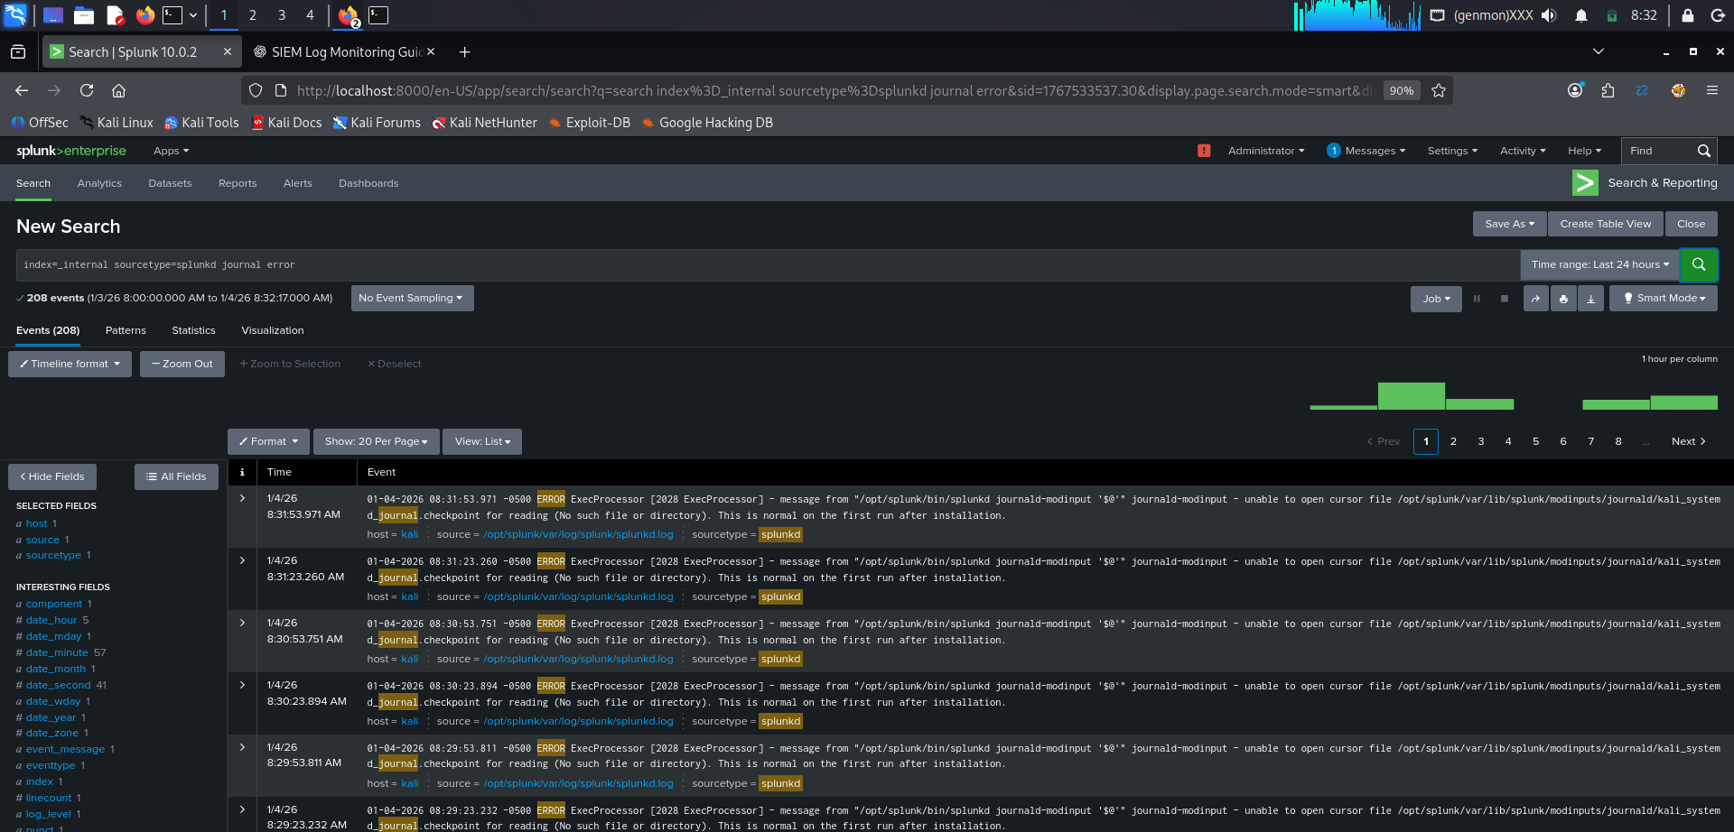
Log Search & Analysis
Sample Search Used:
index=_internal sourcetype=splunkd journal error
Displays system errors
Helps identify failures and warnings

Slide 12
Dashboard Creation
A SIEM dashboard is created to visualize:
Total system errors
Errors over time
systemd journal activity
This helps in quick monitoring and analysis.

Slide 13
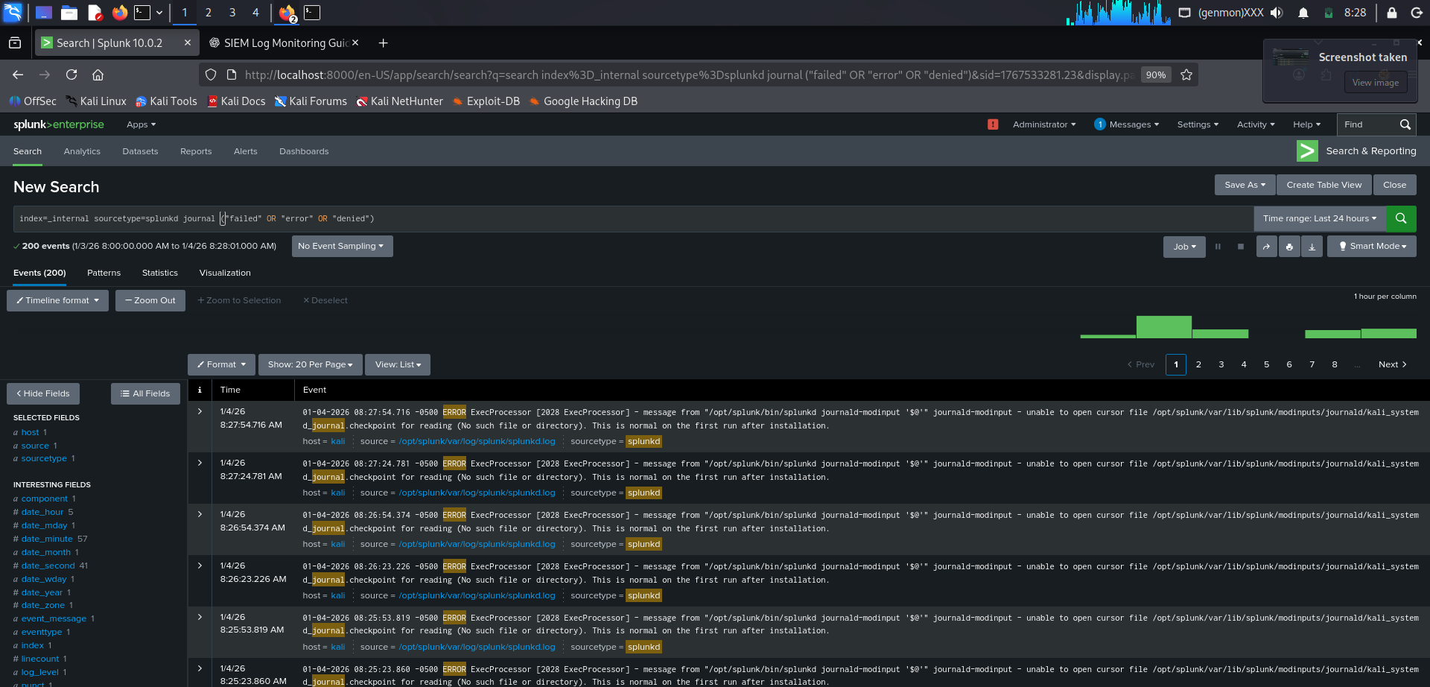
Dashboard Panel 1 – Total System Errors
Purpose
Displays the total number of system errors detected
Helps quickly assess overall system health
Useful for identifying abnormal error spikes
Data Source
_internal index
splunkd and journal logs
Search Query Used
index=_internal sourcetype=splunkd journal error
Visualization Type
Single Value Panel

Slide 14
Dashboard Panel 2 – Errors Per Hour
Purpose:
Shows error trend over time.
Search Used:
index=_internal sourcetype=splunkd journal error
| timechart span=1h count
Visualization:
Line Chart / Column Chart

Slide 15
Dashboard Panel 3 – systemd Journal Activity
Purpose:
Shows activity of different system components.
Search Used:
index=_internal sourcetype=splunkd journal
| stats count by component
Visualization:
Bar Chart / Table

Slide 16
Final Dashboard View
All panels displayed on one dashboard
Real-time monitoring enabled

Slide 17
Results & Observations
Successful log ingestion
Errors detected and analyzed
Dashboard provides clear visibility
Real-time monitoring achieved

Slide 18
Conclusion
This project demonstrates the practical implementation of a SIEM solution using Splunk Enterprise. It shows how system logs can be collected, analyzed, and visualized to detect system issues and security-related events.
The project provides hands-on experience with SIEM tools and reflects real-world SOC operations.

Slide 19
Future Scope
Add alerting mechanism
Monitor SSH login attempts
Integrate multiple log sources
Simulate attack scenarios
SOC-style incident response

Slide 20
THANK YOU !!!

